Slide 1
University of British Columbia Okanagan | 2025
Page
1
Semantic Segmentation of Sentinel-2 Imagery for Crop Type Mapping in Saskatchewan
Using Deep Learning and Targeted Band Selection
Honors Thesis
COSC 449
Presentation by PutriLeksono
Supervisor Dr. Shan Du

Slide 2
University of British Columbia Okanagan | 2025
Page
2
OVERVIEW
Introduction
Research Gap
Result
Literature Review
Objectives
Conclusion
Problem Statement
Methodology
Recommendation

Slide 3
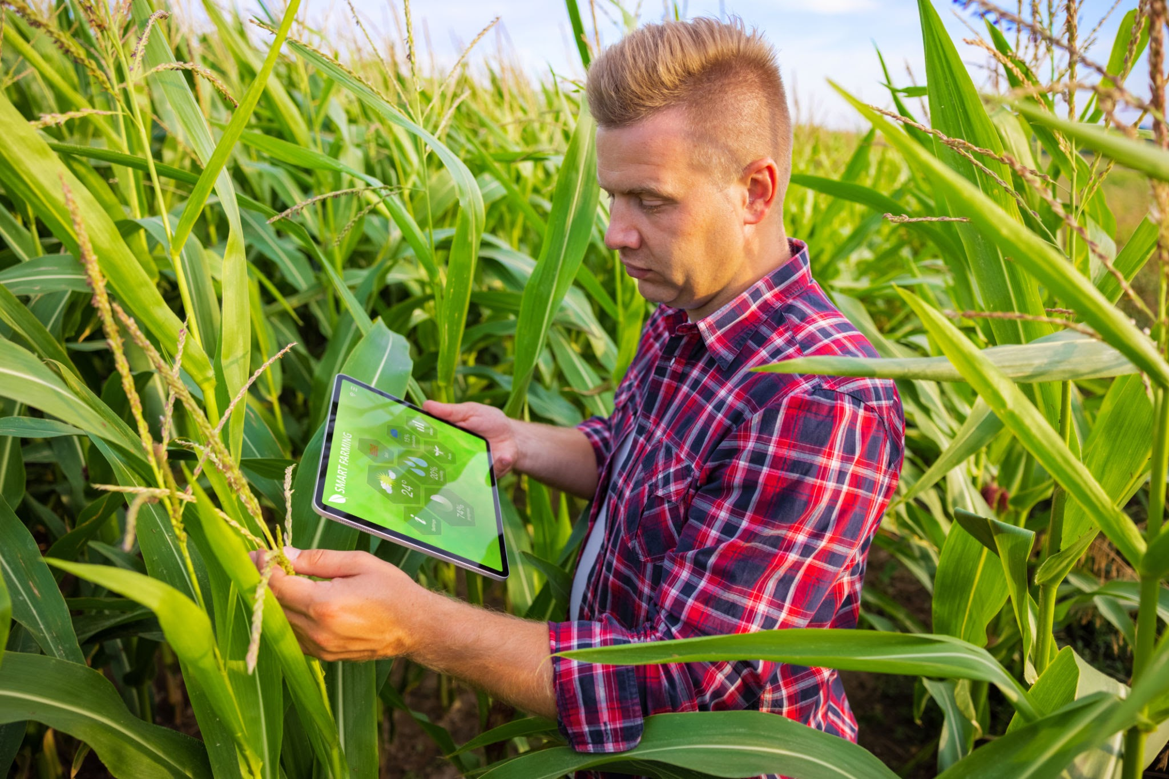
University of British Columbia Okanagan | 2025
Page
04
3
INTRODUCTION
Accurate segmentation of agricultural land is essential for precision agriculture, and satellite imagery offers a scalable solution for large-area monitoring.
However, existing approaches often either use all available spectral bands or rely on commonly used bands, such as those used in indices like NDVI (e.g., B7, B8, B11), which may not be optimized for specific crop types.
This study addresses segmentation challenges by combining statistical band selection methods with deep learning models to optimize performance using fewer, more targeted spectral inputs.

Slide 4
University of British Columbia Okanagan | 2025
Page
4
Literature Review: Challenges in Crop Segmentation
Challenge
Use of Generic Bands:
Spectral Overlap Between Crops:
High inter-class spectral similarity and intra-class variability in multispectral satellite imagery pose significant challenges for accurate crop classification (Wu et al., 2022).
Use of Generic Bands:
Many studies still rely on commonly used bands such as B7, B8, B11, and WVP, which are often chosen due to their role in vegetation indices like NDVI. However, this generic selection may introduce redundancy and fail to capture the crop-specific spectral responses needed for precise segmentation (Zhang et al., 2021; Li et al., 2021).
Notes:
Reference updated work that shows how spectral similarity between crop types (e.g., barley and wheat) makes classification hard, especially in multispectral imagery (e.g., Wu et al., 2022).
Emphasize how using all 12–13 spectral bands can add noise and overfit models. Cite works that experimented with dimensionality reduction or band selection (e.g., Li et al., 2021).

Slide 5
University of British Columbia Okanagan | 2025
Page
5
PROBLEM STATEMENT
Crop Mapping Complexity:
Use of Generic Bands:
Accurately mapping agricultural fields from satellite imagery remains complex due to spectral similarity, cloud coverage, and noise in raw data.
Many segmentation models rely on all Sentinel-2 bands or default band combinations (e.g., B7, B8, B11, WVP), which are not crop-specific and can introduce spectral redundancy.
Need for Precision:
There's a lack of focused research on minimal band selection that still achieves high segmentation accuracy.
Notes:
Many segmentation models rely on all Sentinel-2 bands or default band combinations (e.g., B7, B8, B11, WVP), which are not crop-specific and can introduce spectral redundancy.
This general approach may reduce the model’s ability to distinguish between similar crop types, such as barley, spring wheat, and canola, leading to suboptimal segmentation performance.

Slide 6
University of British Columbia Okanagan | 2025
Page
6
Research Gap
A streamlined, high-performance segmentation pipeline using only key spectral bands is underexplored — especially in high-production regions like Saskatchewan.

Slide 7


University of British Columbia Okanagan | 2025
Page
OBJECTIVES
Train a semantic segmentation model (U-Net & Segformer)
Use specific Sentinel-2 bands
Produce accurate crop area maps for Saskatchewan

Slide 8
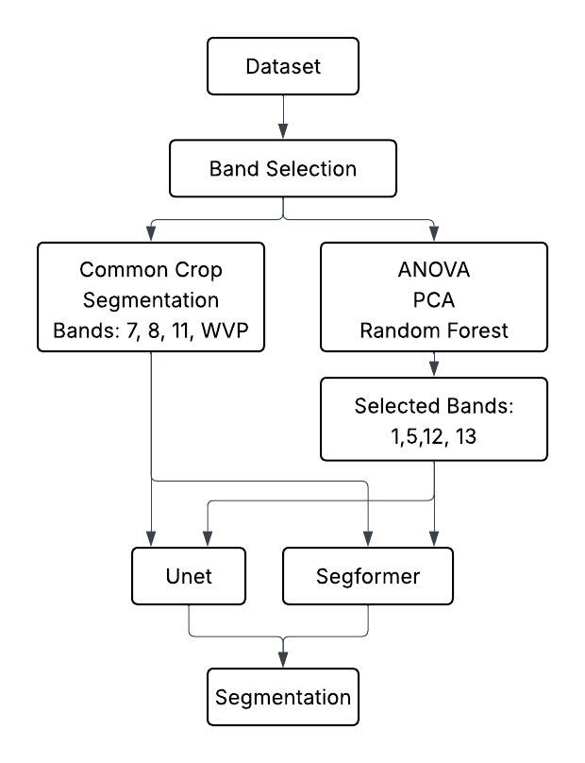
University of British Columbia Okanagan | 2025
Page
METHODOLOGY

Slide 9
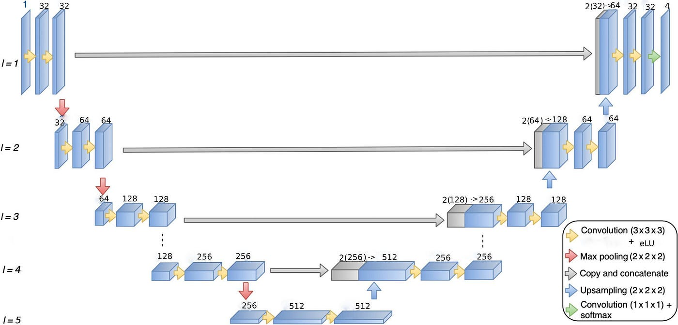
University of British Columbia Okanagan | 2025
Page
U-Net
Encoder-decoder structure with skip connections
Ideal for medical image segmentation and adapted well to remote sensing
Simple architecture with fewer parameters.
4 input channels
4 output classes
Batch size: 1
Learning rate: 0.0001 (1e-4)
Trained 50 epochs with Adam optimizer
Loss: Cross Entropy
Bhavya Rema Devi. (2021, May 22). Tips for training a 3D-Unet model for segmentation tasks. Medium. https://bhavya-rema.medium.com/tips-for-training-a-3d-unet-model-for-segmentation-tasks-5232851d0116

Slide 10
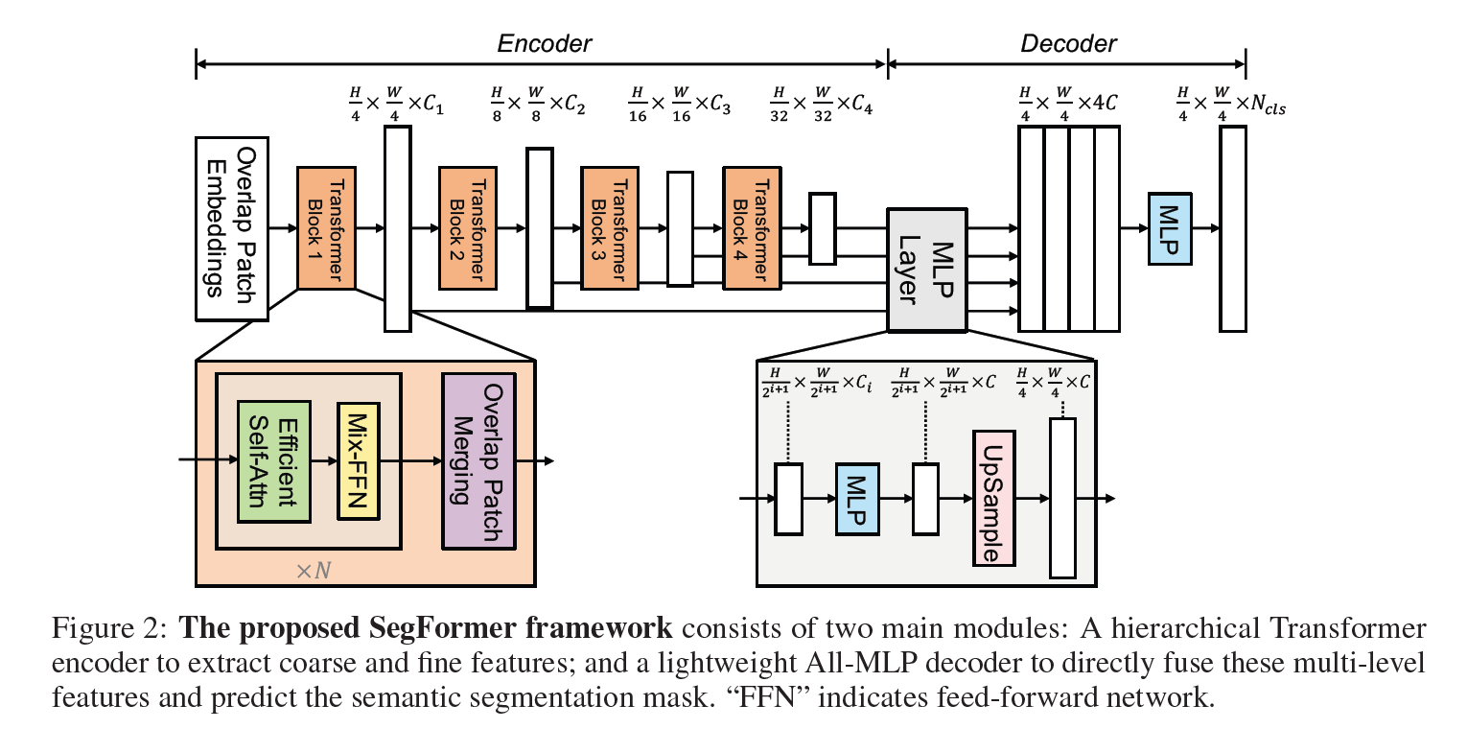
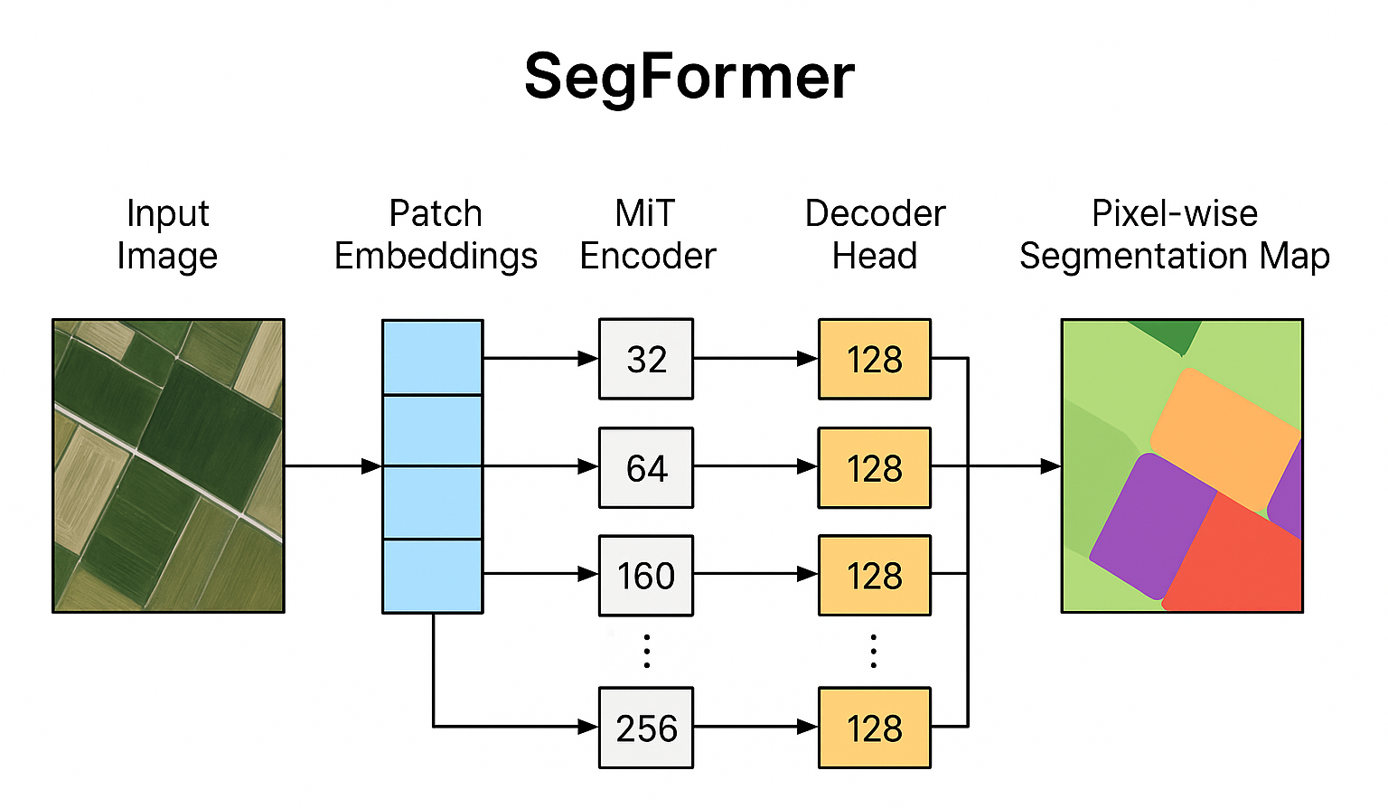
University of British Columbia Okanagan | 2025
Page
Segformer
Transformer-based model with hierarchical encoders.
Handles long-range dependencies better.
No positional encoding—uses learnable embeddings instead, making it efficient.
4 input channels
4 output classes
Batch size: 2
Learning Rate: 0.0001 (1e-4)
Trained 50 epochs with AdamW optimizer
Loss function: Cross-Entropy Loss.
Xie, E., Wang, W., Yu, Z., Anandkumar, A., Alvarez, J. M., & Luo, P. (2021). SegFormer: Simple and Efficient Design for Semantic Segmentation with Transformers. arXiv preprint arXiv:2105.15203. Available at: https://arxiv.org/abs/2105.15203
Notes:
Stable convergence: U-Net has lots of layers (downsampling and upsampling). A higher learning rate like 1e-3 (0.001) can make the training unstable (loss might jump wildly). 1e-4 keeps the updates small and steady.
Smooth optimization: Especially when using Adam optimizer (which you are), 1e-4 is often recommended because Adam already adjusts learning rates internally (adaptive learning), so you don’t need a huge base value.
Common practice: Many segmentation papers and tutorials using U-Net start with 1e-4 and then later reduce it if needed for fine-tuning.

Slide 11
University of British Columbia Okanagan | 2025
Page
Why Unet & Segformer?
Feature | U-Net | Segformer
Architecture | CNN-based | Transformer-based
Memory Efficiency | High | Moderate
Handles Global Context | ❌ | ✅
Ease of Training | Easier | Needs more resources
Number of Params | Fewer | More

Slide 12
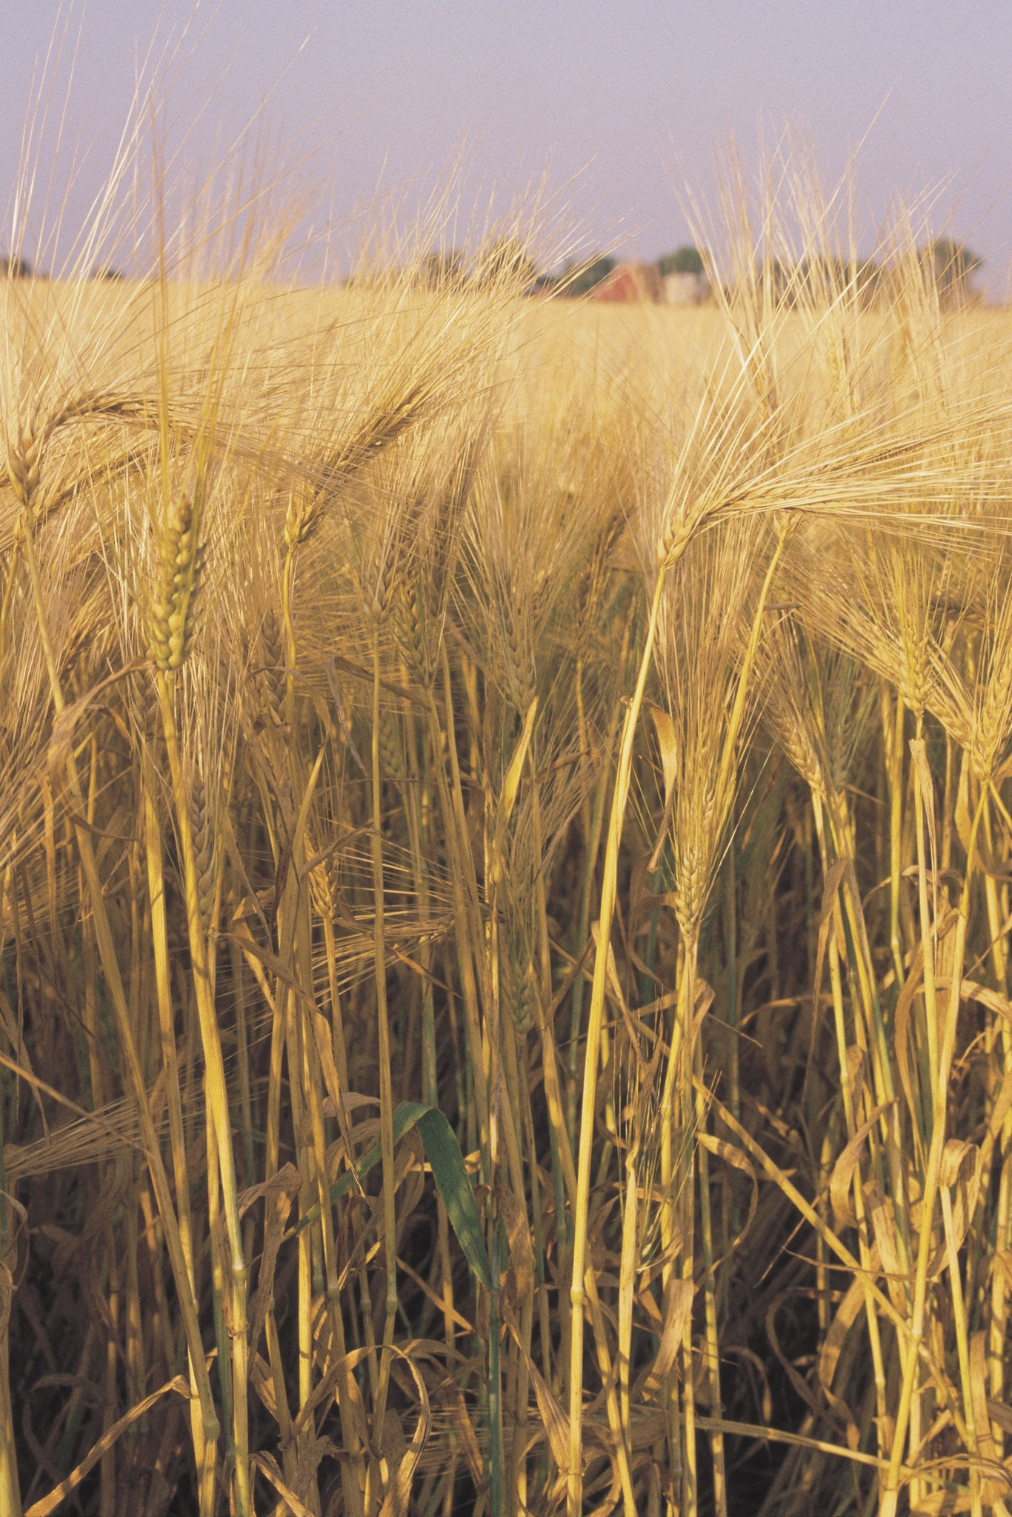
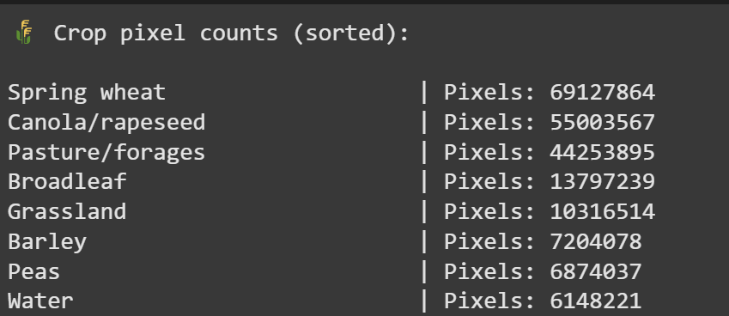
University of British Columbia Okanagan | 2025
Page
Study Area & Dataset
Saskatchewan: major crops (Barley, Wheat, Rapeseed)
Data: Sentinel-2 imagery (Summer 2023)
Crop masks from Canadian open government data

Slide 13
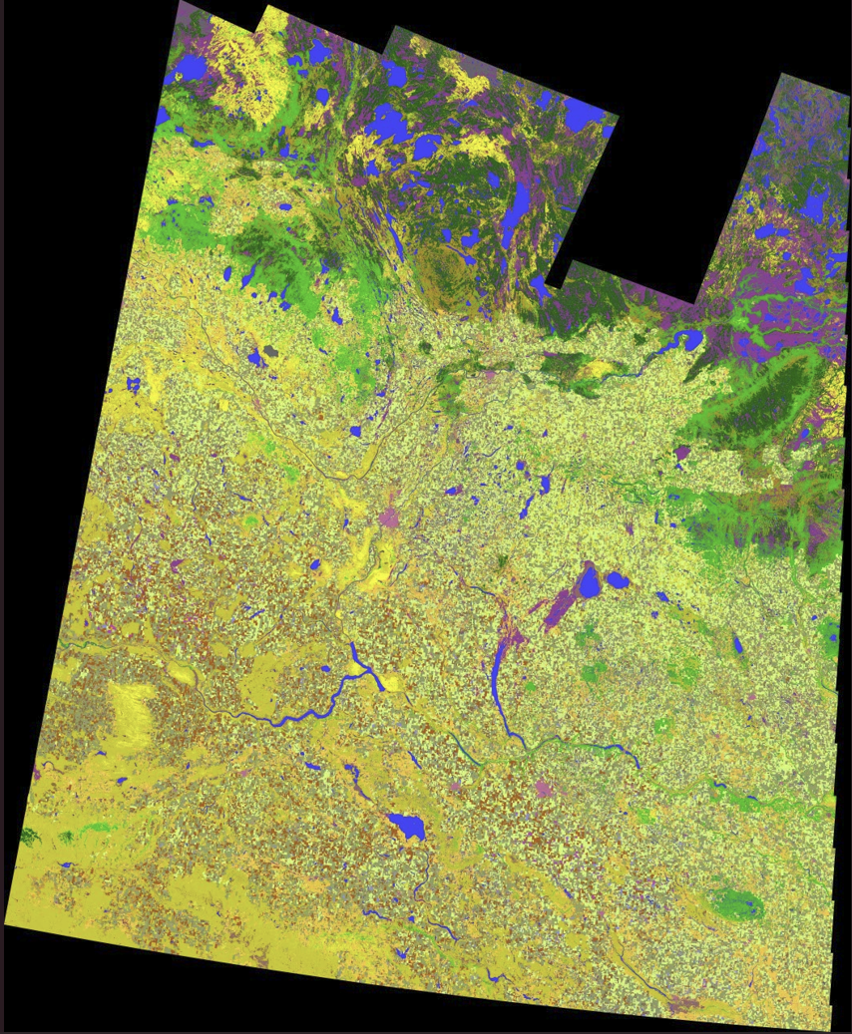
University of British Columbia Okanagan | 2025
Page
Why Saskatchewan?
Major Agricultural Hub
Crop Diversity
Rich Public Datasets
Flat Geography
Agriculture and Agri-Food Canada. Annual Crop Inventory 2023. Government of Canada Open Data Portal. Retrieved from https://open.canada.ca/data/en/dataset/5d3ab93e-324a-41db-8d29-0f0813d0e9cd
Notes:
Major Agricultural Hub:
Saskatchewan is one of Canada’s largest agricultural provinces, contributing significantly to national and global crop production.
Crop Diversity:
It produces large quantities of barley, wheat, and rapeseed (canola) — ideal for testing segmentation of multiple crop types.
Rich Public Datasets:
Government of Canada provides open-access crop type maps and census data, making it ideal for reproducible academic research.
Flat Geography:
Saskatchewan’s relatively uniform terrain reduces topographic distortion in satellite imagery, improving segmentation accuracy.
Research Relevance:
Results can directly benefit precision agriculture and policy planning in one of Canada’s most critical farming regions.

Slide 14
University of British Columbia Okanagan | 2025
Page
Why Sentinel-2?
High Spatial Resolution
Rich Spectral Information
Frequent Revisit Time
Free and Open Access
Large Area Coverage
Proven Use in Agriculture
Agriculture and Agri-Food Canada. Annual Crop Inventory 2023. Government of Canada Open Data Portal. Retrieved from https://open.canada.ca/data/en/dataset/5d3ab93e-324a-41db-8d29-0f0813d0e9cd
Notes:
Major Agricultural Hub:
Saskatchewan is one of Canada’s largest agricultural provinces, contributing significantly to national and global crop production.
Crop Diversity:
It produces large quantities of barley, wheat, and rapeseed (canola) — ideal for testing segmentation of multiple crop types.
Rich Public Datasets:
Government of Canada provides open-access crop type maps and census data, making it ideal for reproducible academic research.
Flat Geography:
Saskatchewan’s relatively uniform terrain reduces topographic distortion in satellite imagery, improving segmentation accuracy.
Research Relevance:
Results can directly benefit precision agriculture and policy planning in one of Canada’s most critical farming regions.

Slide 15
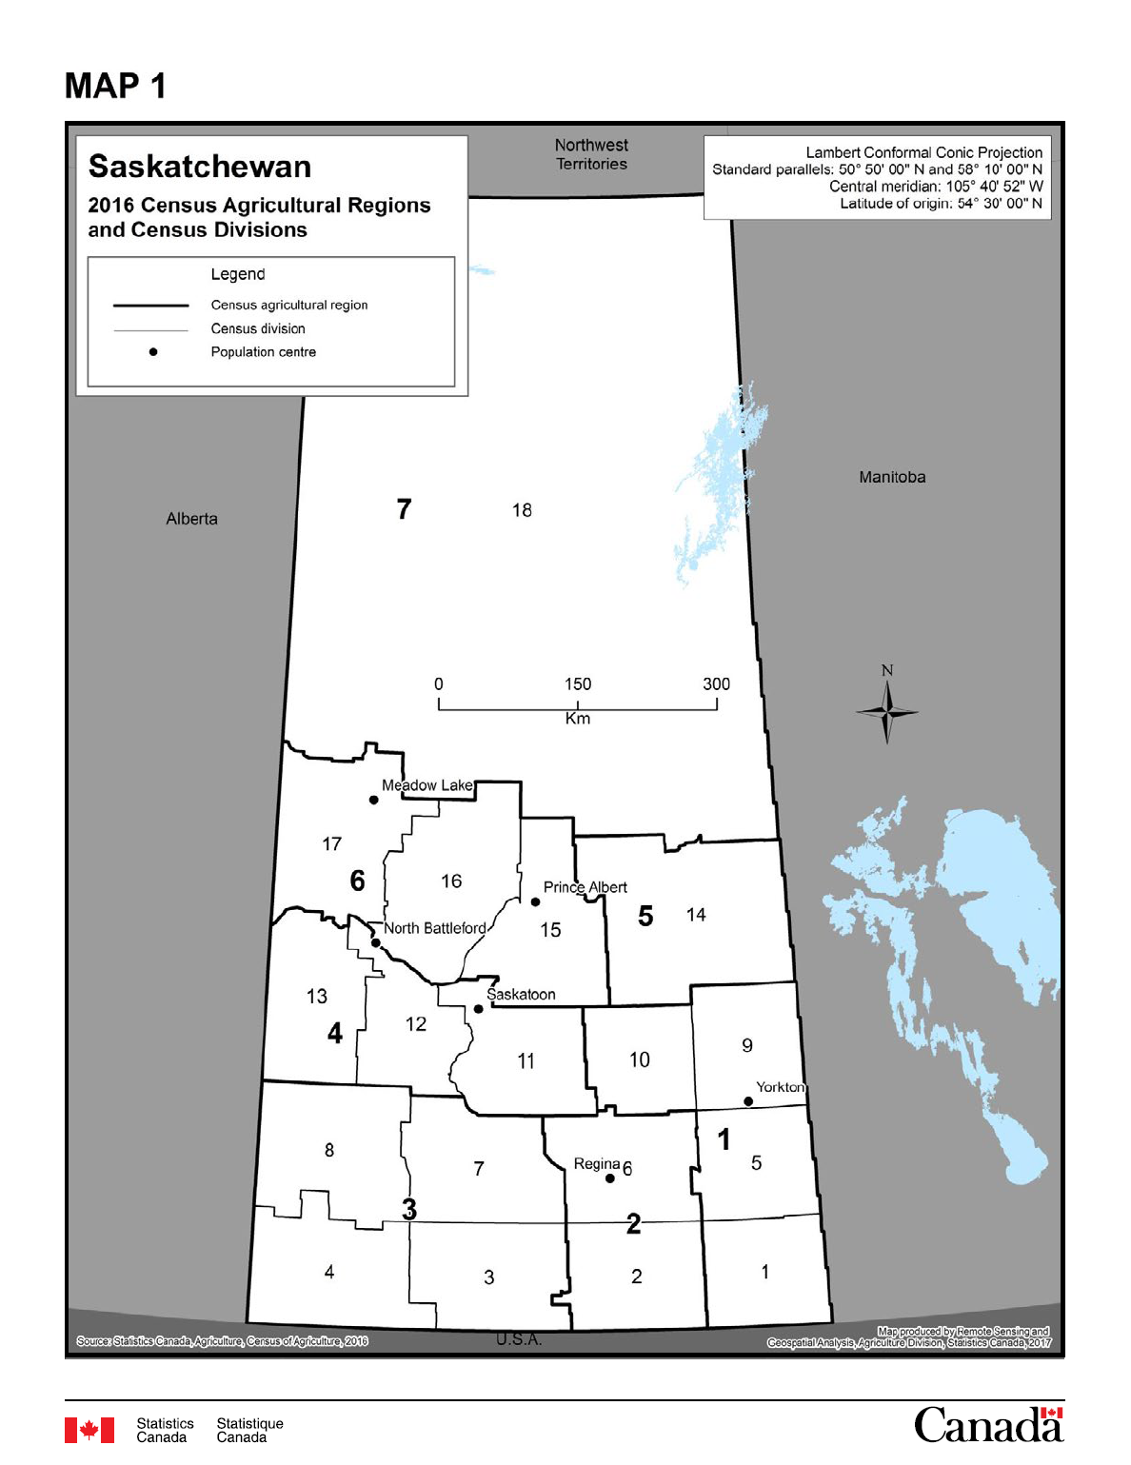
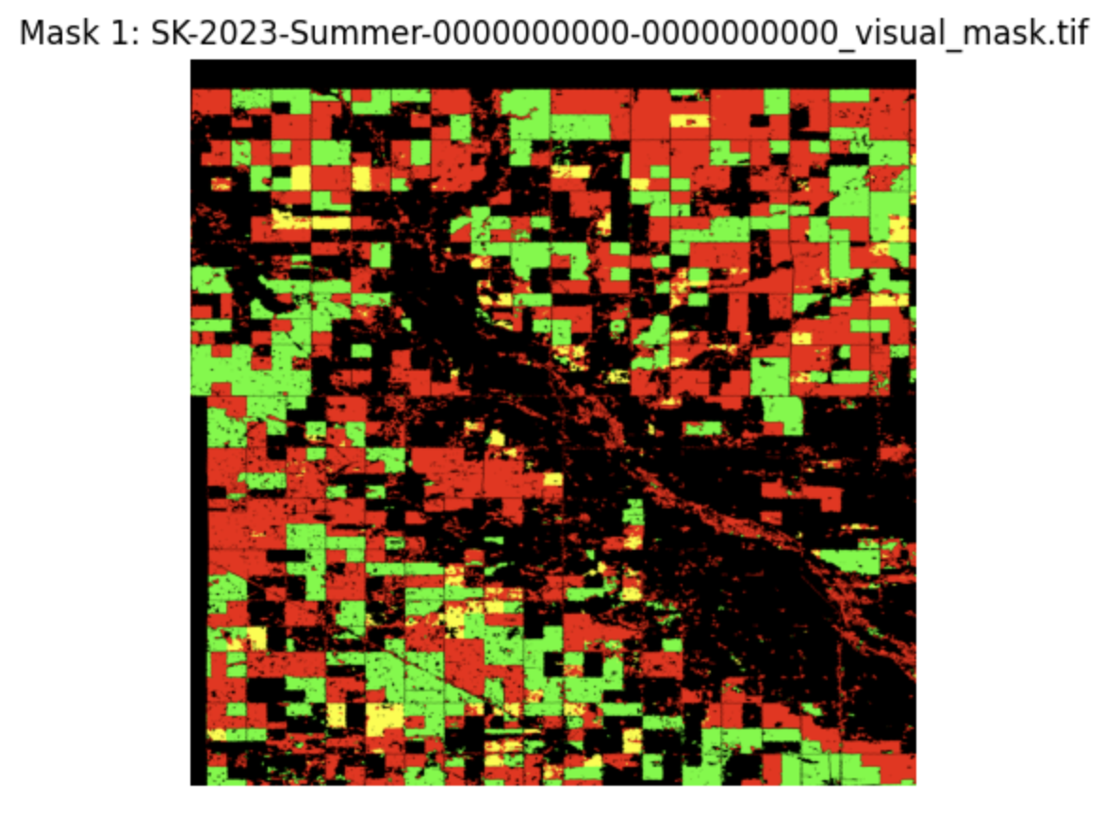
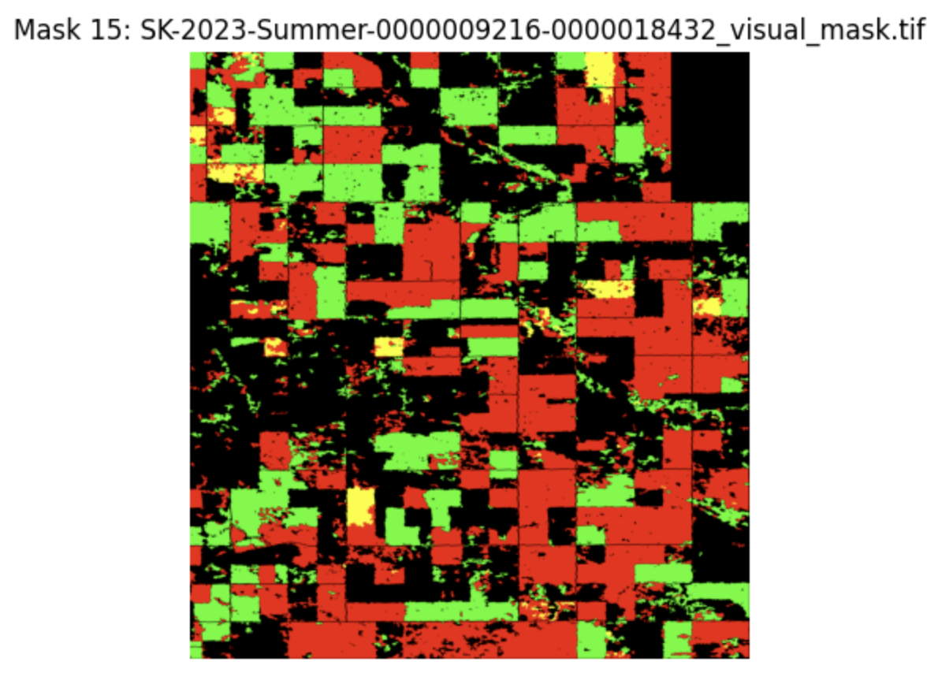
University of British Columbia Okanagan | 2025
Page
Dataset
Using Canada 2016 Census Agricultural Regions, and census divisions. Data from region 1 is used and divided into 15 segments.
Statistics Canada. (2016). Census Agricultural Regions and Census Divisions – Saskatchewan (Map 1). In 2016 Census of Agriculture – Agricultural Regions and Census Divisions (Catalogue no. 95-634-XWE). Retrieved from https://www.statcan.gc.ca

Slide 16
University of British Columbia Okanagan | 2025
Page
TIFF File: /content/drive/MyDrive/SK-Ground1/SK-2023-Summer-0000000000-0000000000.tif
Dimensions: 4608 x 4608 pixels
Total Bands: 26
CRS: EPSG:4326
Transform: | 0.00, 0.00,-103.24|
| 0.00,-0.00, 50.06|
| 0.00, 0.00, 1.00|
Metadata: {'driver': 'GTiff', 'dtype': 'float64', 'nodata': None, 'width': 4608, 'height': 4608, 'count': 26, 'crs': CRS.from_wkt('GEOGCS["WGS 84",DATUM["WGS_1984",SPHEROID["WGS 84",6378137,298.257223563,AUTHORITY["EPSG","7030"]],AUTHORITY["EPSG","6326"]],PRIMEM["Greenwich",0,AUTHORITY["EPSG","8901"]],UNIT["degree",0.0174532925199433,AUTHORITY["EPSG","9122"]],AXIS["Latitude",NORTH],AXIS["Longitude",EAST],AUTHORITY["EPSG","4326"]]'), 'transform': Affine(8.983152841195215e-05, 0.0, -103.23529076629953,
0.0, -8.983152841195215e-05, 50.06409893079346), 'blockxsize': 256, 'blockysize': 256, 'tiled': True, 'compress': 'lzw', 'interleave': 'pixel'}
Band Names: ('B1', 'B2', 'B3', 'B4', 'B5', 'B6', 'B7', 'B8', 'B8A', 'B9', 'B11', 'B12', 'AOT', 'WVP', 'SCL', 'TCI_R', 'TCI_G', 'TCI_B', 'MSK_CLDPRB', 'MSK_SNWPRB', 'QA10', 'QA20', 'QA60', 'MSK_CLASSI_OPAQUE', 'MSK_CLASSI_CIRRUS', 'MSK_CLASSI_SNOW_ICE')

Slide 17
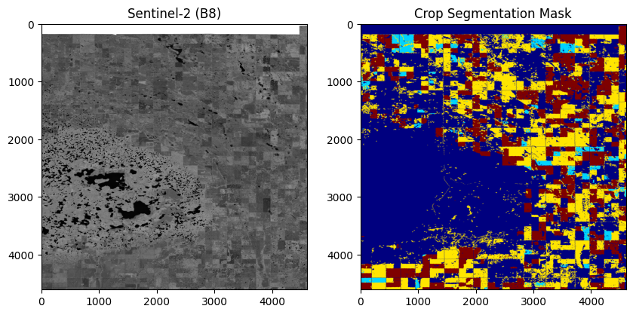
University of British Columbia Okanagan | 2025
Page
Preprocessing
Normalize reflectance (÷10,000)
Handle NaNs
Resize to 256×256
Augment: flip, rotate, brightness/contrast

Slide 18
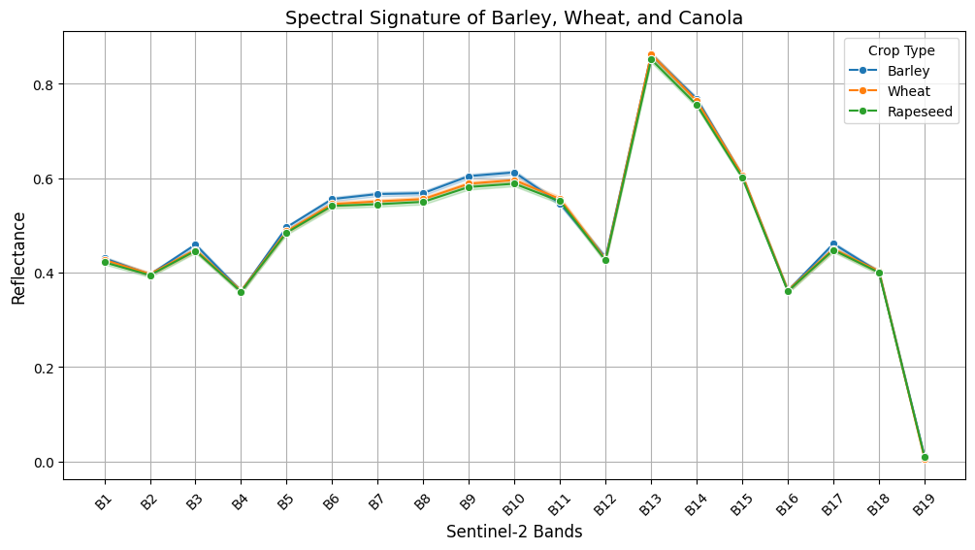
University of British Columbia Okanagan | 2025
Page
BAND SELECTION

Slide 19
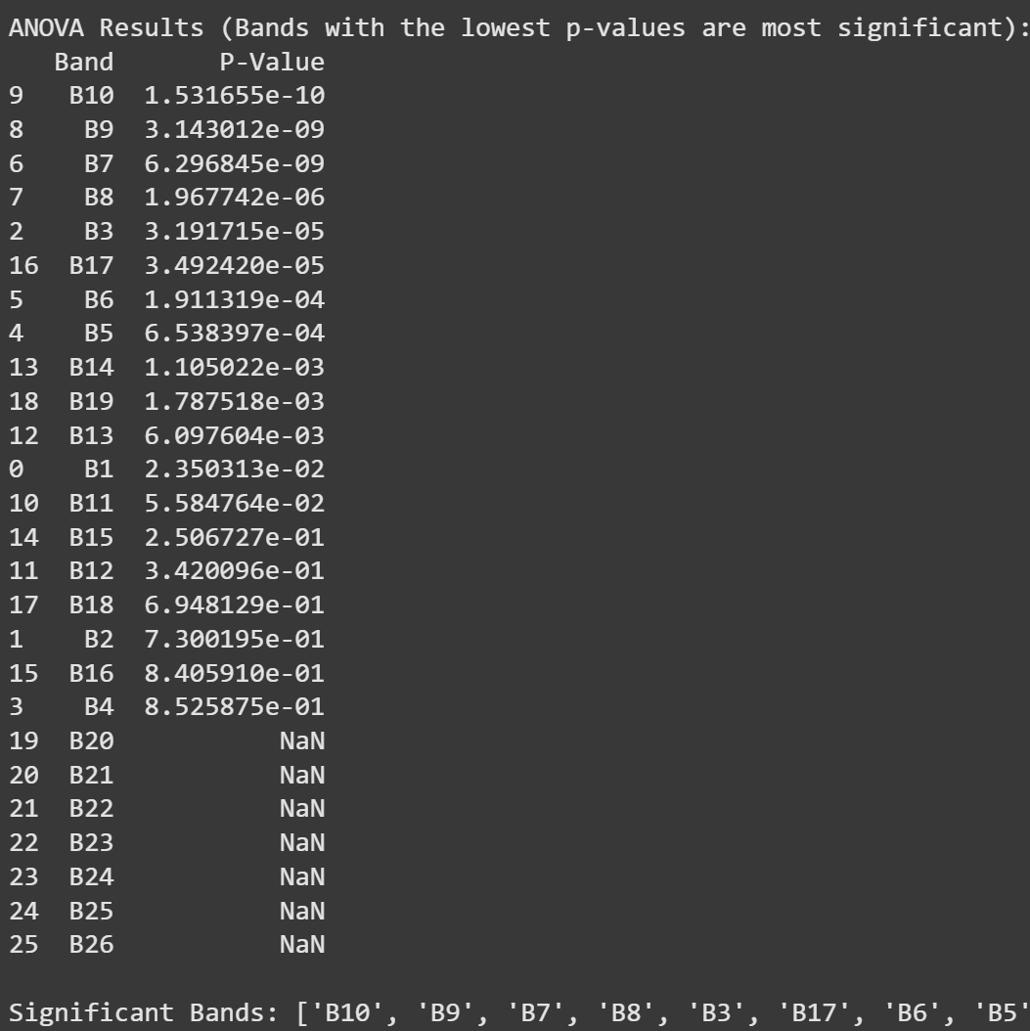
University of British Columbia Okanagan | 2025
Page
ANOVA
What it measures: Whether the reflectance values of a band differ significantly across crop types (Barley, Wheat, Rapeseed).
Output: A list of p-values for each band. Lower p-values = more significant.
Selection: Keeps only bands with p-value < 0.05, indicating statistically significant differences.
Result: ["B10", "B9", “B7”, “B8”, “B3”, ...]

Slide 20
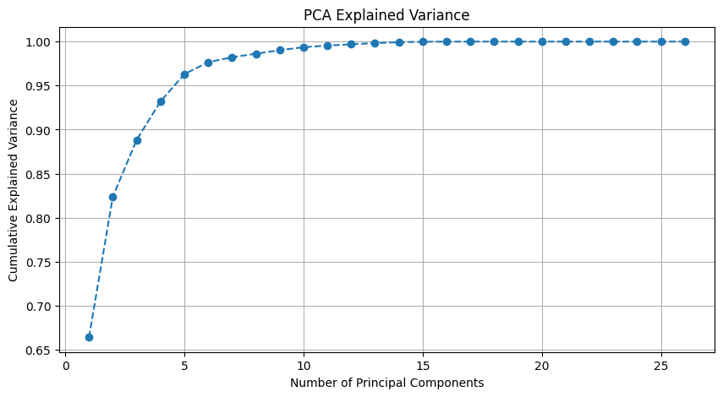

University of British Columbia Okanagan | 2025
Page
PCA
What it measures: The contribution of each band to explaining the variance in the data.
Output: Component loadings, showing how much each band contributes to each principal component.
Selection: Calculates total absolute contribution to all principal components, then selects top 5 contributing bands.
Result: ["B14", "B3", "B17", "B5", "B12", ..]

Slide 21
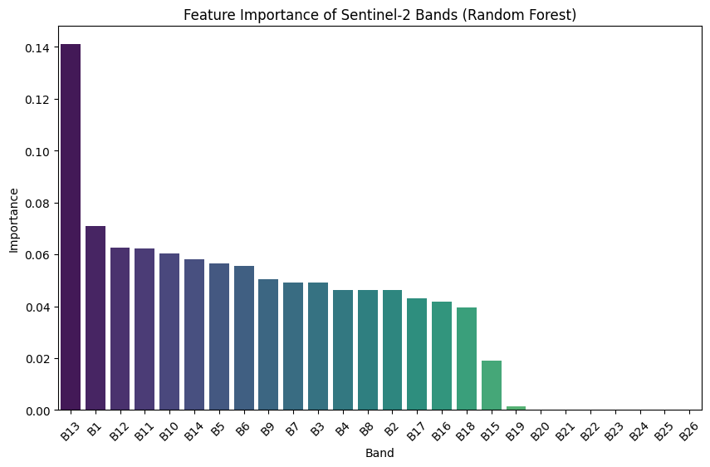
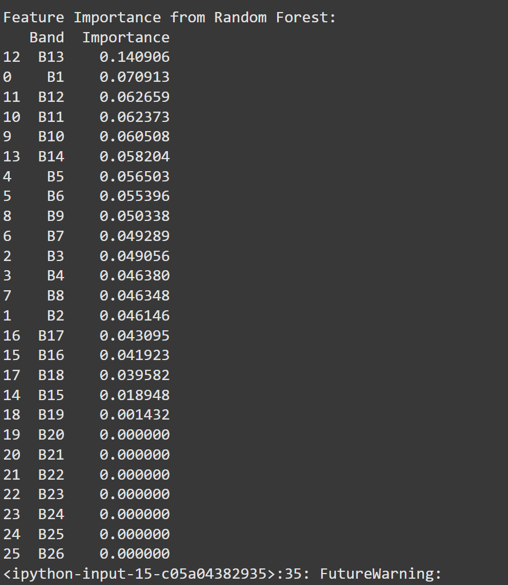
University of British Columbia Okanagan | 2025
Page
RANDOM FOREST

Slide 22
University of British Columbia Okanagan | 2025
Page
RANDOM FOREST
What it measures: Feature importance for classifying crop type.
Output: Each band gets a score based on how often and effectively it is used to split decision trees.
Selection: Chooses top 5 bands with the highest importance scores.
Result: ["B13", "B1", "B12", "B11", "B10",...]

Slide 23
University of British Columbia Okanagan | 2025
Page
Chosen Bands: Set Union
ANOVA: Selected bands based on statistical variance
PCA: Reduced dimensionality to most informative bands
Random Forest: Ranked bands by importance
Chosen Bands:
Literature-based: B7, B8, B11, WVP
Data-driven: B1, B5, B12, B13

Slide 24
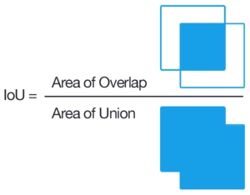
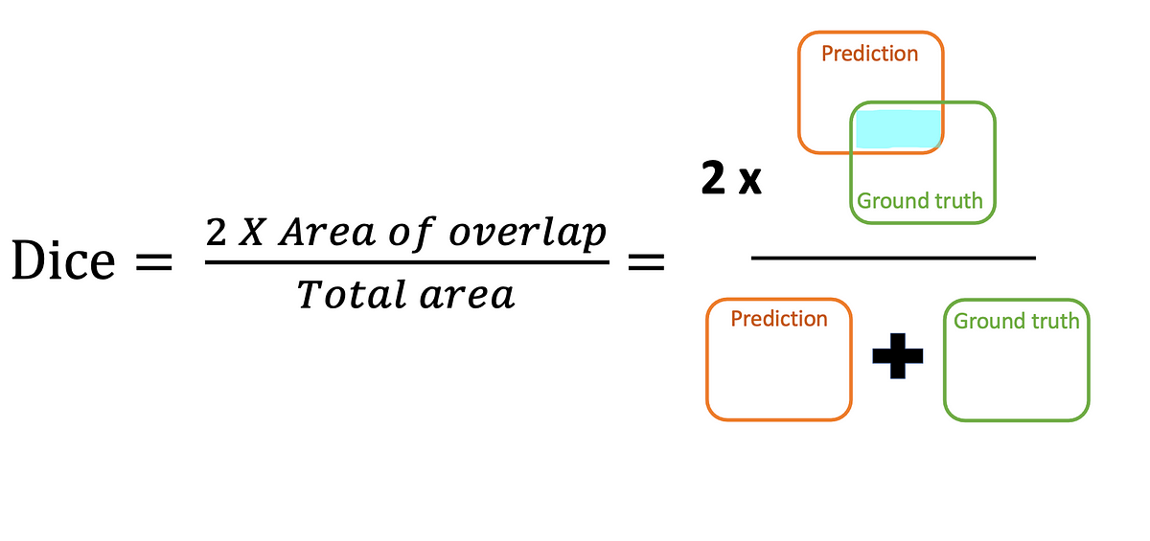
University of British Columbia Okanagan | 2025
Page
Evaluation Metrics
Intersection over Union (IoU): Measures overlap between predicted and ground truth regions.
Dice Coefficient: A similarity index between prediction and ground truth masks.
Pixel Accuracy: Percentage of correctly classified pixels.

Slide 25
U-Net
RESULT

Slide 26
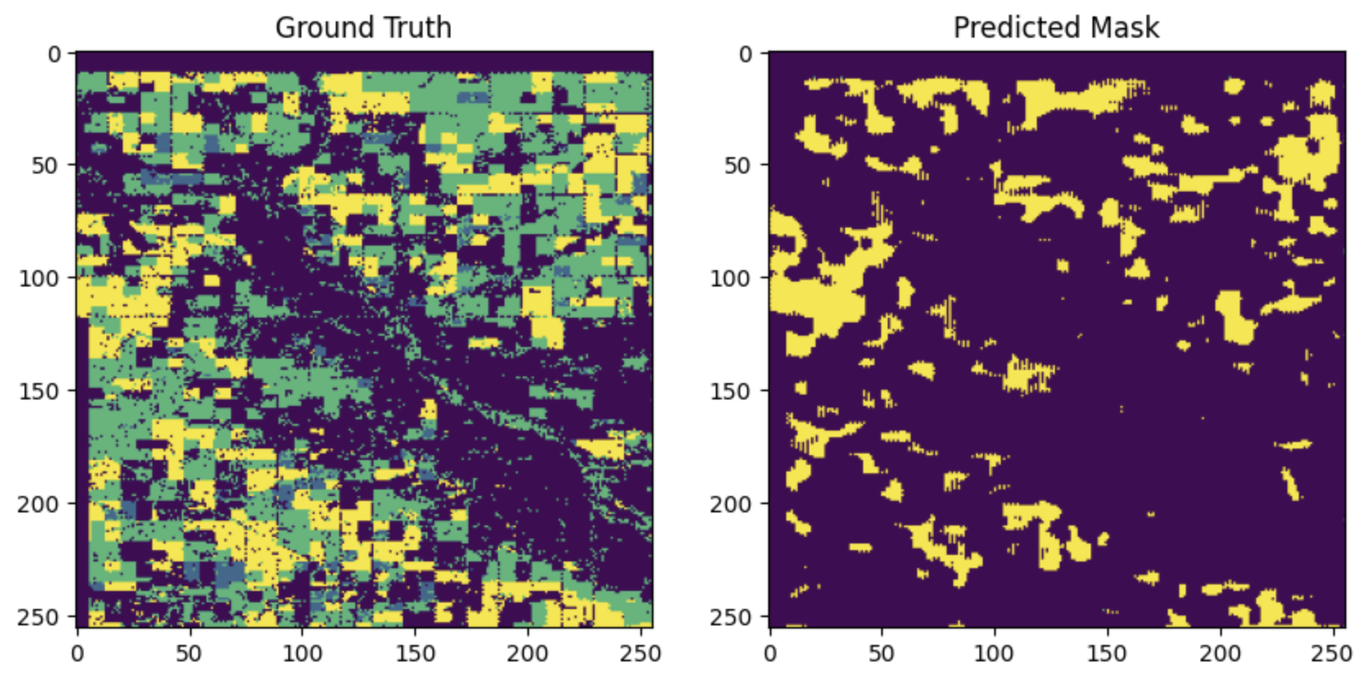
University of British Columbia Okanagan | 2025
Page
RESULT
Using all of the bands

Slide 27
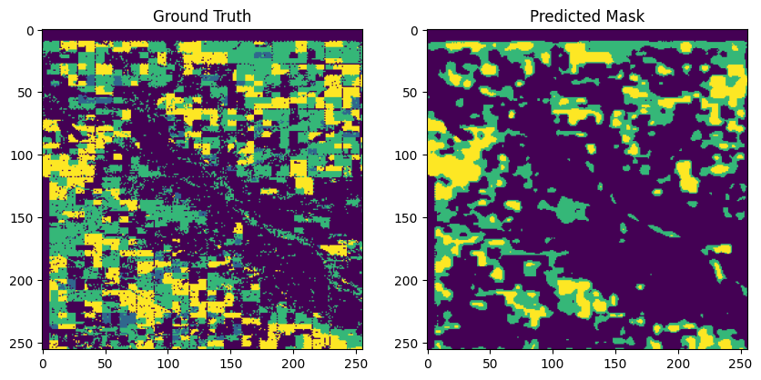
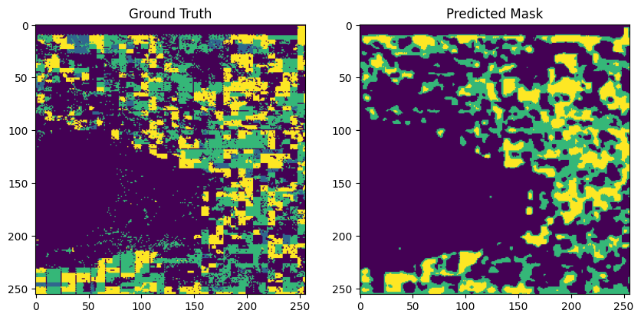
University of British Columbia Okanagan | 2025
Page
RESULT
Bands : 7, 8, 11, 14
Accuracy: 0.6101
Mean IoU: 0.3750
Dice Score: 0.4321
Visual output matches crop boundaries well

Slide 28
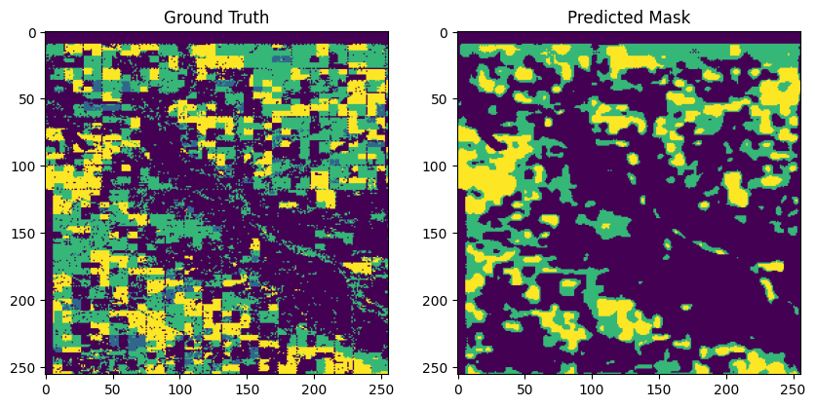
University of British Columbia Okanagan | 2025
Page
RESULT
From Literature Review
Bands : 7, 8, 11, 14
Accuracy : 0.6101
Derived from feature extraction Bands : 1, 5, 13, 12
Accuracy : 0.6441

Slide 29
Segformer
RESULT

Slide 30
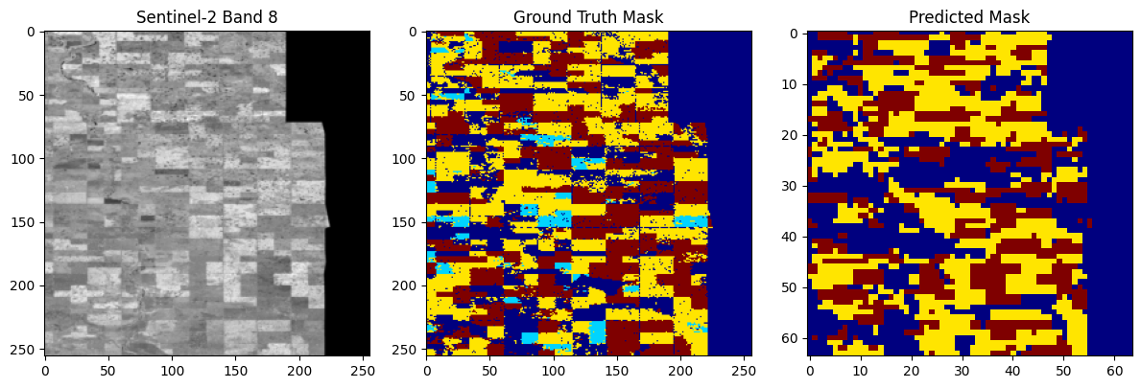
University of British Columbia Okanagan | 2025
Page
Bands : 7, 8, 11, 14
Accuracy: 0.6603
Mean IoU: 0.4494
Dice Coefficient: 0.3363

Slide 31
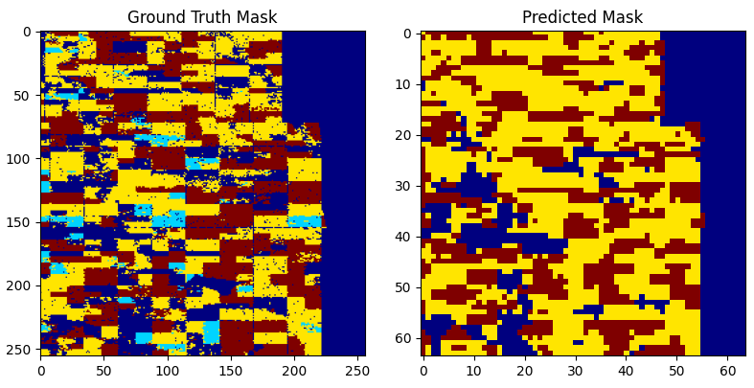
University of British Columbia Okanagan | 2025
Page
RESULT
From Literature Review
Bands : 7, 8, 11, 14
Accuracy : 0.6603
Derived from feature extraction Bands : 1, 5, 12, 13
Accuracy : 0.6861

Slide 32
University of British Columbia Okanagan | 2025
Page
RESULT
 | Accuracy | Dice Score | Iou Score
U-Net Common Bands | 0.6101 | 0.3775 | 0.4321
U-Net ML Bands | 0.6420 | 0.3797 | 0.4221
Segformer Common Bands | 0.6603 | 0.3363 | 0.4494
Segformer ML Bands | 0.6861 | 0.3735 | 0.4870

Slide 33

University of British Columbia Okanagan | 2025
Page
CONCLUSION
Selecting the right bands can lead to better accuracy and Dice Score
SegFormer can achieve better accuracy, mean IoU, and Dice Coefficient than U-Net

Slide 34

University of British Columbia Okanagan | 2025
Page
FUTURE WORK
Evaluate Across different years
Try Deeplab or U-Net++
Generalize to other regions/crop types

